Slide 1
CodeX
Insights and recommendations to the marketing team

Slide 2
Problem Statement
CodeX’s marketing team faces the challenge of establishing a strong brand presence in a highly competitive Indian Market. Their primary objectives are to:
Increase Brand Awareness
Expand market share
Product Development
My Task- Extract meaningful insights from the data which would help the marketing team achieve the objectives.

Slide 3
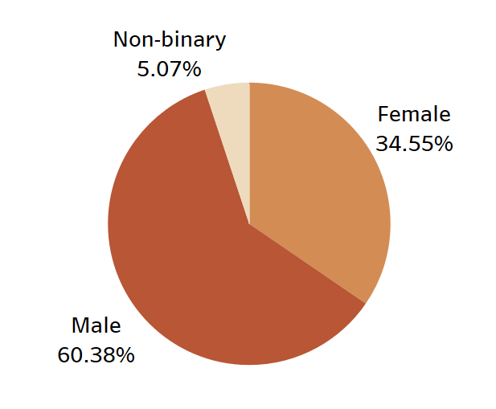
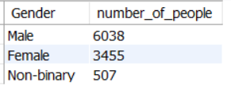
Demographics Insights
a) Who prefers energy drinks more?
Out of 10000 participants about 60 % of the respondents were male so we can say that Male prefer energy drinks more.

Slide 4
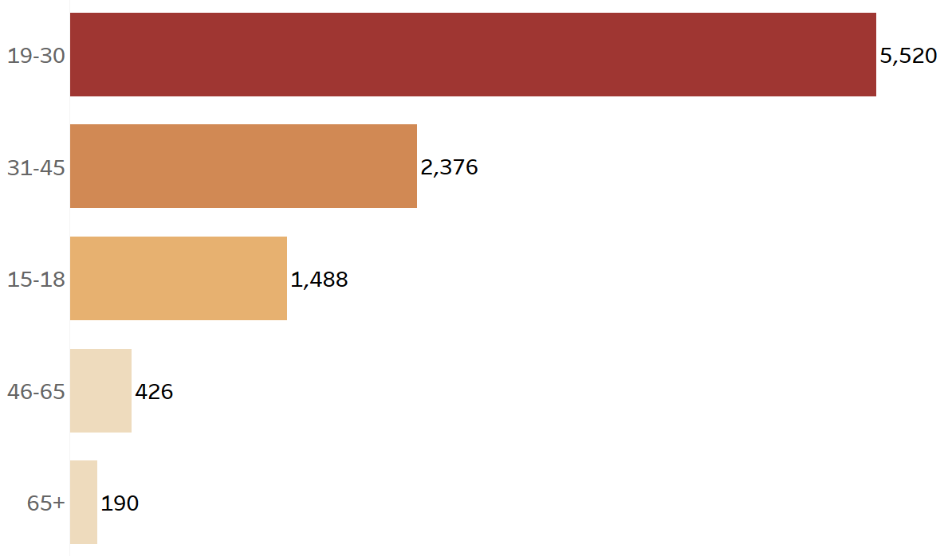
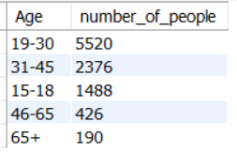
Demographics Insights
b) Who age group prefers energy drinks more?
Nearly 55% of the participants were in the age group of 19-30 so this age group prefers the energy drink more.

Slide 5
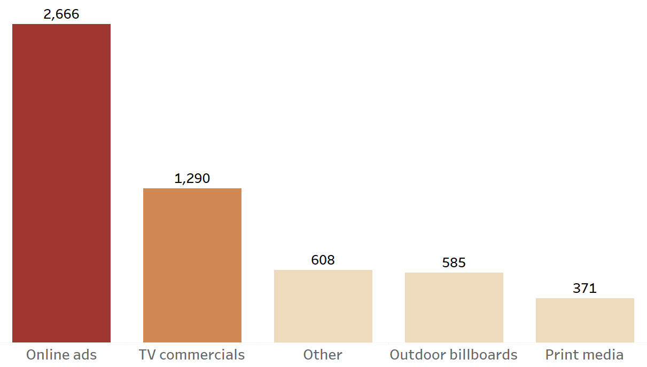
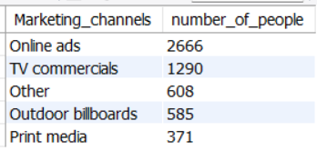
Demographics Insights
c) Which type of marketing reaches most youth(15-30)?
Online ads reach more youth than any other marketing channel.

Slide 6
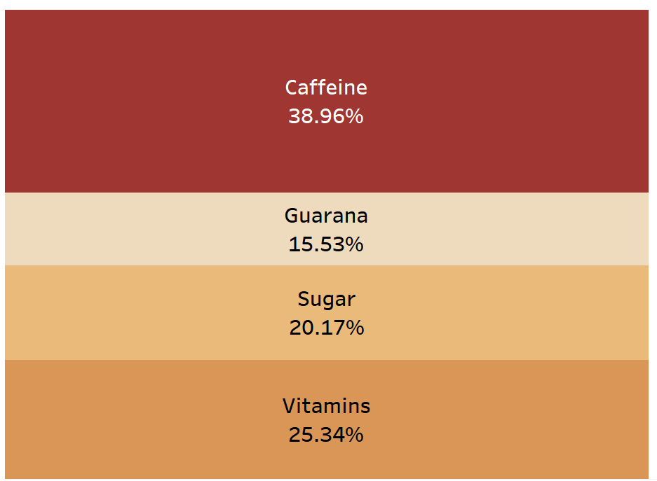
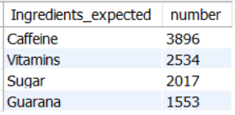
Consumer preferences
a)What are the preferred ingredients of energy drinks among respondents?
Most of the respondents prefer Caffeine followed by Vitamins.

Slide 7
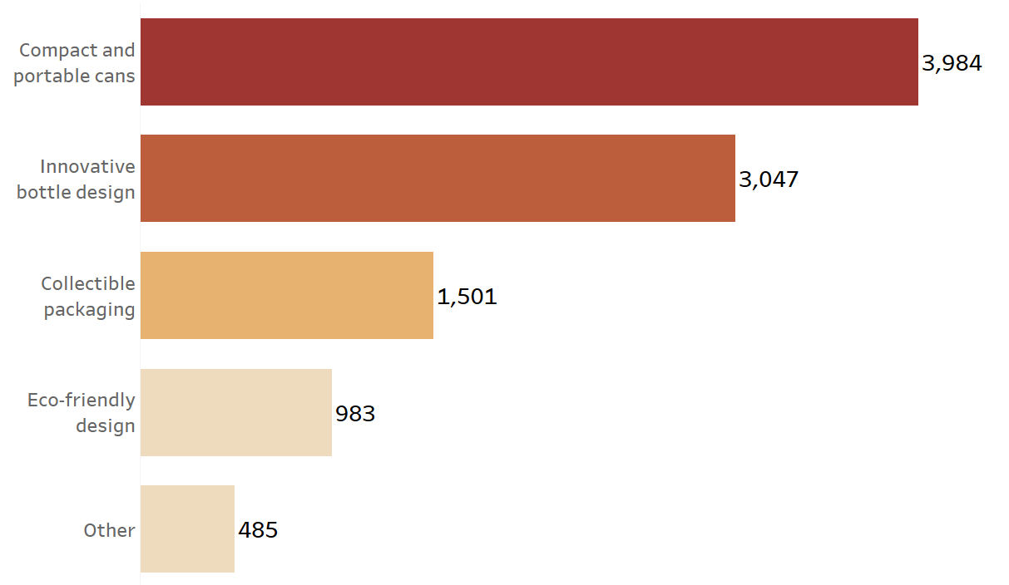
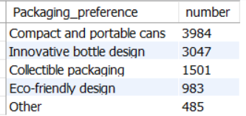
Consumer preferences
b)What packaging preferences do respondents have for energy drinks?
Respondents prefer Compact and portable cans followed by innovative bottle design.

Slide 8
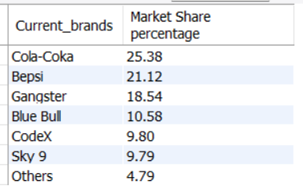
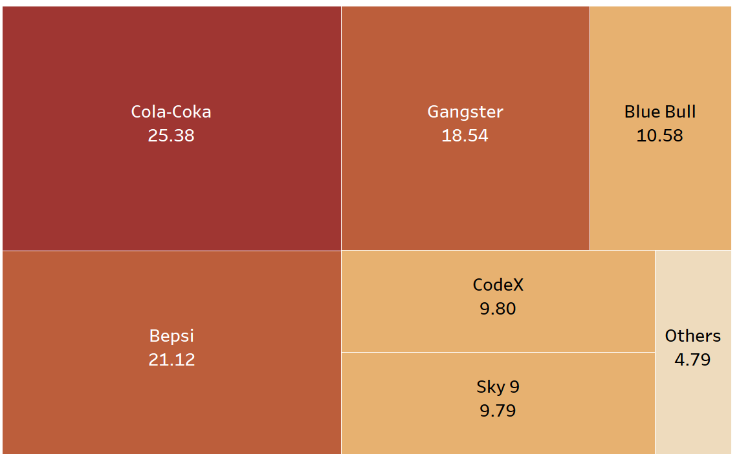
Competition analysis
a)Who are the current market leaders?
Market leaders are Cola-Coka and Bepsi has 45% market share and are the market leaders in this drink business.

Slide 9
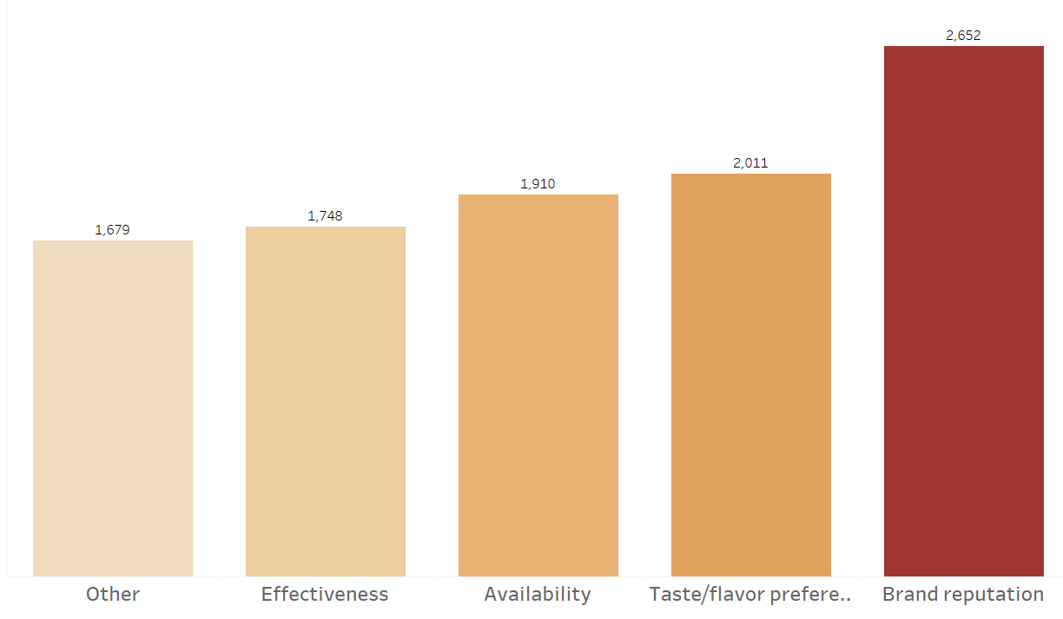
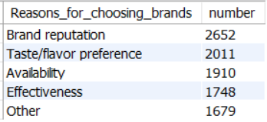
Competition analysis
b) What is the primary reason people prefer those brands over ours?
Brand reputation is the primary reason for people choosing the brand of the drink.

Slide 10
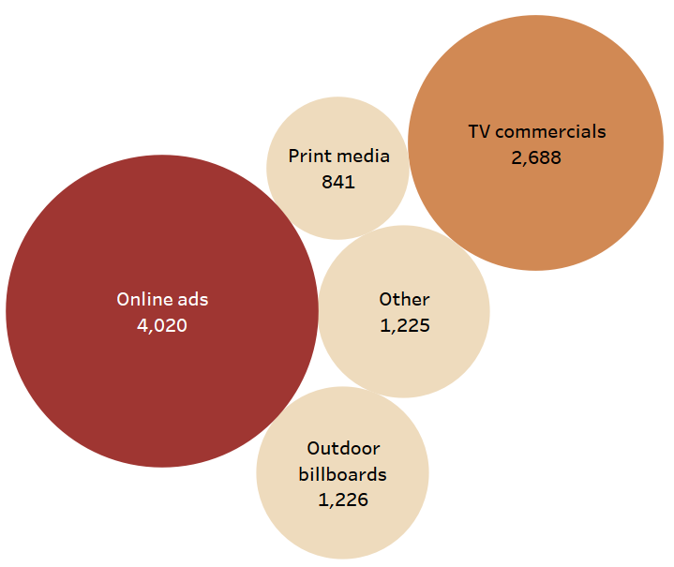
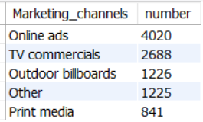
Marketing Channels and brand awareness
a) Which marketing channels can be used to reach more customers?
More resources should be allocated towards the Online ads and TV commercials.

Slide 11
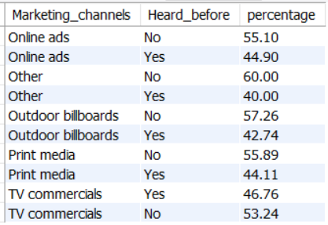
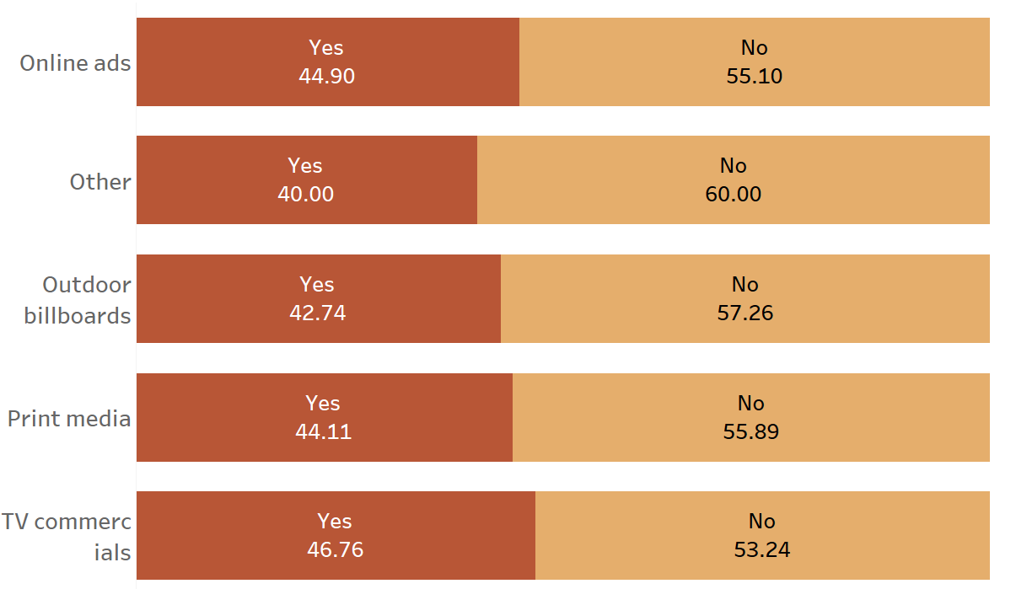
Marketing Channels and brand awareness
b)How effective are different marketing strategies and channels reaching our customers?
Tv Commercials are the most effective at 53.24 %,followed by Online Ads at 44.90% then print media at 44.11%.

Slide 12
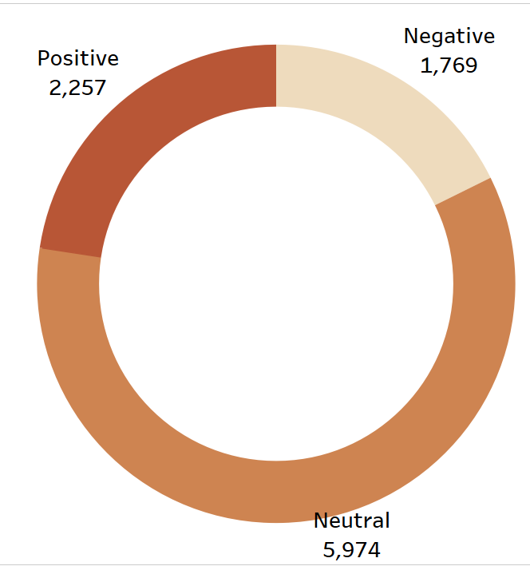
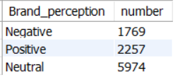
Brand Penetration
a)What do people think about our brand?(overall rating)
Majority of the people are neutral about our brand and the number of positive ratings is greater than the number of negative ratings.

Slide 13
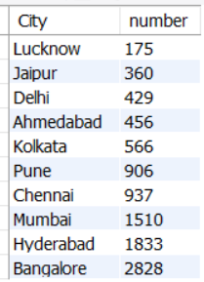
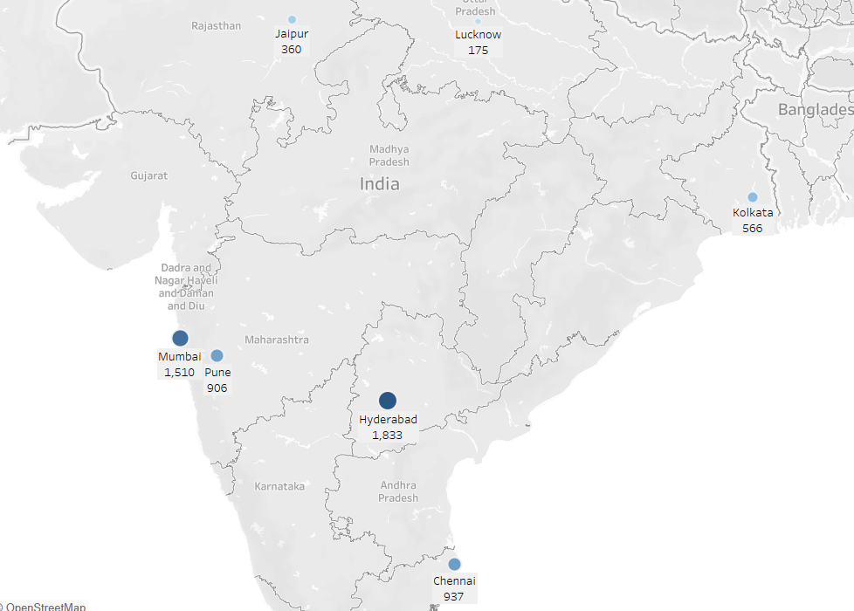
Brand Penetration
b)What cities do we need to focus more on?
Top 3 cities to focus on are Lucknow,Jaipur,Delhi

Slide 14
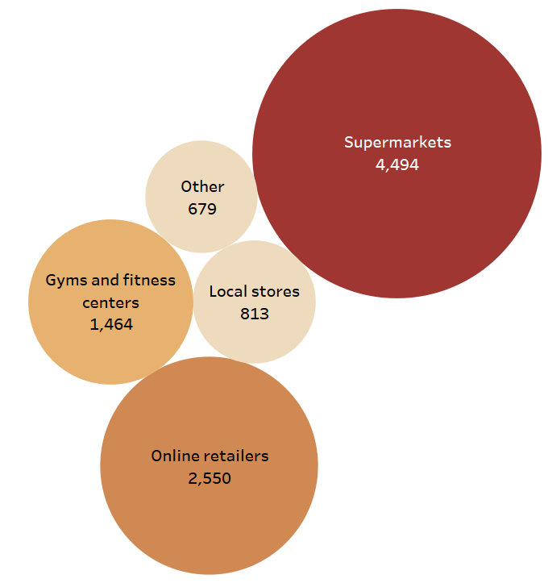
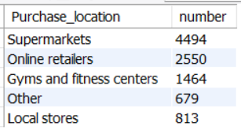
Purchase Behaviour
a)Where do respondents prefer to purchase energy drinks?
Most of the respondents prefer to purchase energy drinks from Supermarkets.

Slide 15
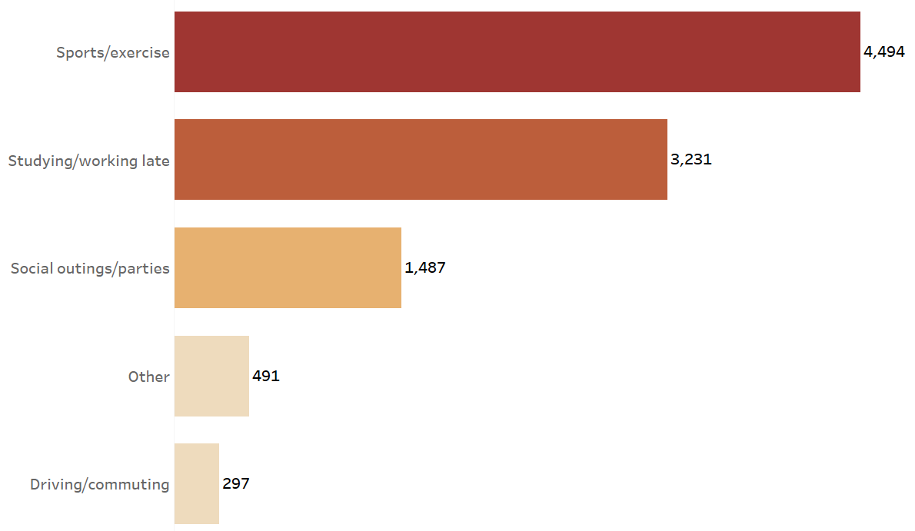
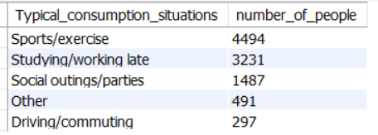
Purchase Behaviour
b)What are the typical consumption situations for energy drinks among respondents?
Nearly 76% of people prefer to have energy drinks during Sports/exercise and studying/working late.

Slide 16
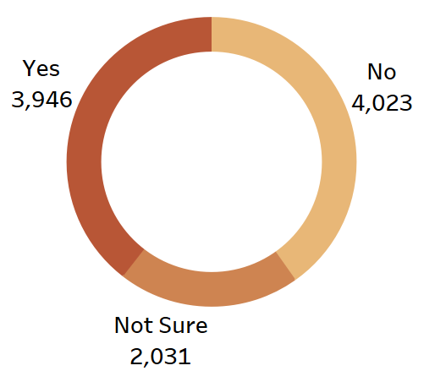
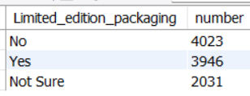
Purchase Behaviour
c)What factors influence respondents purchase decisions such as price range and limited edition packaging?

Slide 17
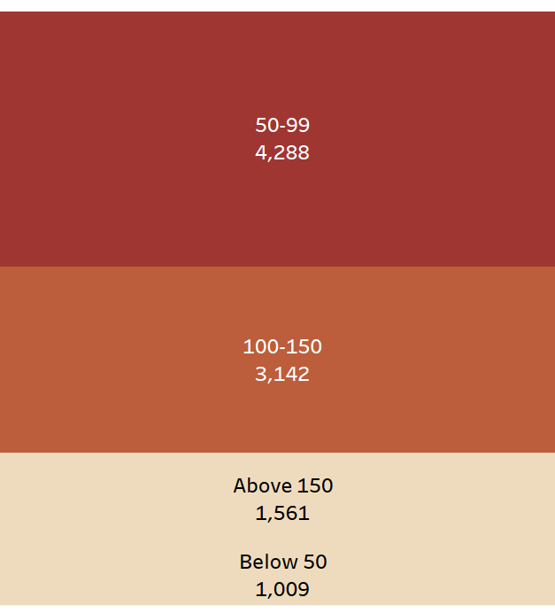
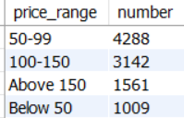
Purchase Behaviour
c)What factors influence respondents purchase decisions such as price range and limited edition packaging?
We can see that selling drinks as limited_edition_packaging has no effect on improving the sales of the product.But the price range has an effect on the number of people buying energy drinks as the price range of people buying those drinks decreases.

Slide 18
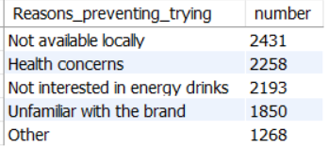
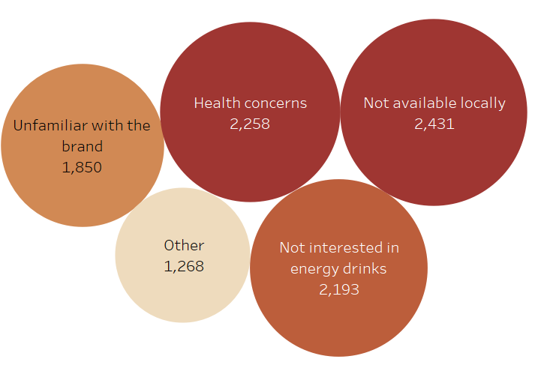
Product Development
Which area of business should we focus more on our product development?(Branding/taste/availability)?
The company should try to improve the availability of the energy drinks and also focus on marketing these products so people will get familiar with the brand and should not be worried about any health concerns.

Slide 19
Recommendations
The company should increase the availability of energy drinks in the market.
The company should increase the presence in the cities Lucknow,Delhi,Jaipur,Ahmedabad,Kolkata
The company should focus on releasing products at the price of less than Rs 150.
The company should spend more money on marketing,advertisement in promoting their energy drink and building brand perception focusing more on Online ads,TV commercials and promoting products at supermarkets.
Companies may build an alternative product which is appealing to people over 45 years of age.

